Slide 1

ICP 1023 OO Programming in Java
Laboratory 1 – Revision
School of Computer Science, Bangor University

Slide 2
Laboratory 1: Aims and Objectives
Aims
To revise fundamental concepts from ICP 1022
Objectives
Implement simple algorithms in Java
Use methods to structure program solutions
Use library methods to solve problems (e.g. random number generation)
Access data stored in files

Slide 3
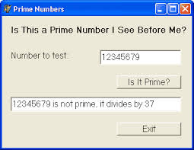
What is an Algorithm?
An unambiguous, executable, and terminating specification of a way to solve a problem.
Big Java: Late Objects
Glossary

Slide 4
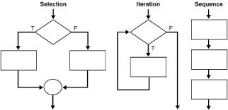
Control Constructs

Slide 5
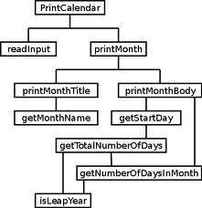
Stepwise Refinement
Break a big task into smaller tasks
Map the smaller tasks to Java
Stepwise refinement is a heuristic not an algorithm

